Slide 1
An Ontology Based Approach to Action Verification for Agile Manufacturing
19 Dec 2013
Stephen Balakirsky, Georgia Tech Research Institute
&
Zeid Kootbally, University of Maryland

Slide 2
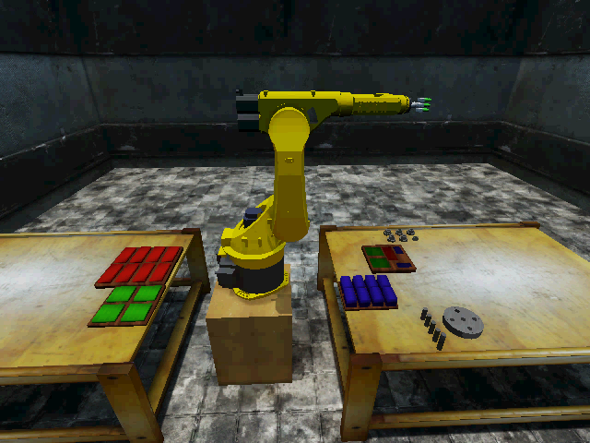
Ontology System
Desire to have “agile”, “flexible” system for assembly operations
Do not want to:
Require fixture for parts and trays
Reprogram basic cell operation for new configurations
Do want:
Ability to recover from errors and failures
Ability to vary assembly plan based on need (build multiple kits at the same work cell)
Ability to interact with factory infrastructure (auto-report supply needs, errors, …)
Can an ontology system help with these tasks?
Talk will present system design for ontology based agile assembly cell
Details of ontology provided in paper

Slide 3
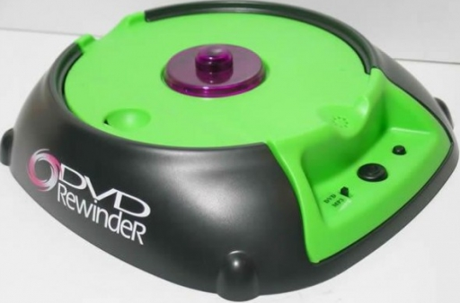
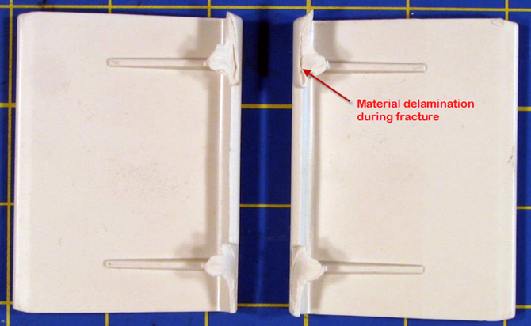
What is a “failure”?
“Any change, design, or manufacturing error that renders a component, assembly, or system incapable of performing its intended function”¹
For this presentation, I will address part/component availability failures
Inaccurate information on part location
Part damage
Incorrect part type
Part shortage
The techniques developed in this work may be generalized into other failure modes
¹J. Collins

Slide 4
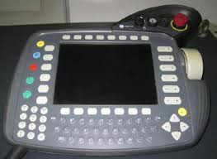
Today’s Environment
Modern industrial robots are capable of sub-millimeter accuracy
Often run repeated operations that are programed through a teach pendent
Provide large-batch, error-free operation
Does not lend itself well to adaptation for failure mitigation
Need platforms that are able to provide:
Failure correction/detection
Rapid retasking
Industrial subcommittee of the IEEE Robotics and Automation Society’s Ontologies for Robotics and Automation Working group has taken first steps to build the infrastructure necessary for failure correction and rapid retasking

Slide 5
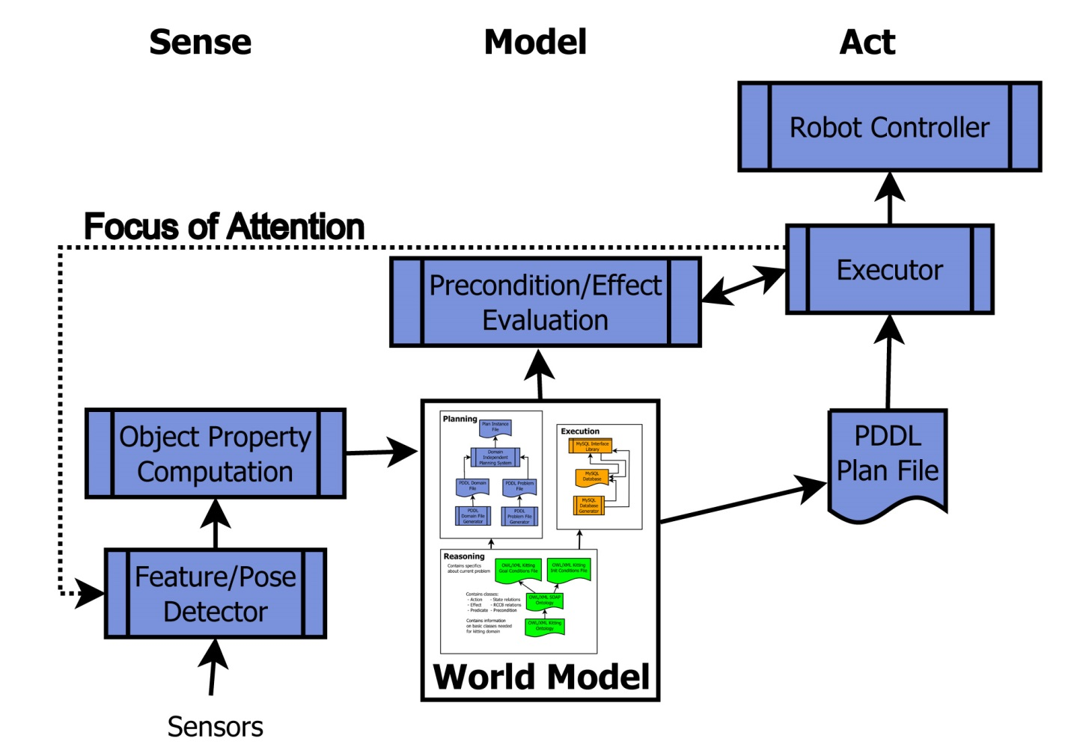
Overall System Architecture

Slide 6
World Model
World model decomposed into reasoning, planning, and execution sections
Reasoning knowledge encoded in ontology
Planning and Execution knowledge automatically generated prior to runtime

Slide 7
Reasoning
Reasoning section contains ontology used to automatically generate planning and execution portions of model
Represented in OWL and XML Schema
Structured in three parts
Upper ontology – Used to create parameters for the Planning World Model and skeleton tables for the MySQL database of the Execution World Model
States, Ordering constraints, Actions, and Predicates (SOAP) ontology – Used to generate actions rules, preconditions, and effects for the PDDL domain file
Instance ontology – Used to create the PDDL problem file

Slide 8
Planning
Planning system based on Planning Domain Definition Language (PDDL)
World model consists of domain and problem files
Domain file contains predicates and actions
Problem file contains objects, initial state and goal specification
Allows family of open source planners to be utilized by system
Generates static plan file
Contains sequence of actions
Provides for late binding of instances to plan

Slide 9
Execution
Build around MySQL database
Auto-generated:
Table composition
Population of tables with initial conditions
C++ access functions
Contains latest available data on exact instance locations
Execution system
Keeps world model up-to-date by soliciting updates from vision system
Utilizes this section of world model to provide binding of instances for robot action

Slide 10
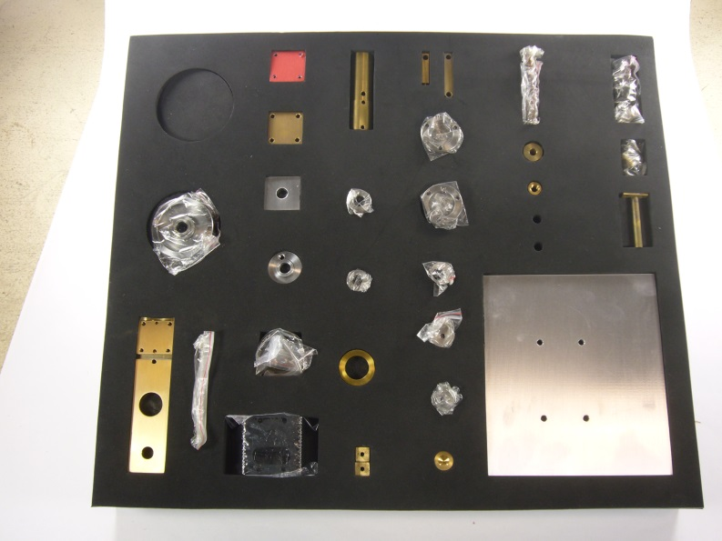
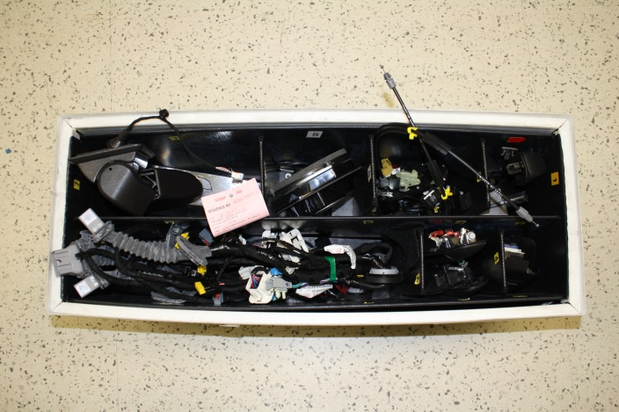
Application to Kit Building
Mixed-model assembly requires that multiple product variants be built on same line
An assembly kit is a specific collection of components and or subassemblies that support one or more assembly operations
Provide for basic assembly sequence:
Pick-up an empty kit and place it on work table
Pick-up multiple component parts, inspect them, and place them in the kit
Pick-up completed kit and place it in storage

Slide 11

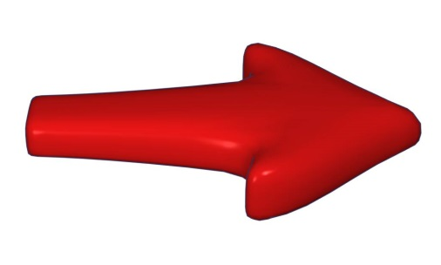
Utilizing Knowledge For Assembly
Robot has core vocabulary known as the Canonical Robot Control Language
Vocabulary may be composed to create complex operations (e.g. Pick-up part)
Complex operations have preconditions that must be satisfied before they are deemed valid to execute (e.g. Effector-Empty)
Complex operations have effects that are expected to occur as result of execution (e.g. ┐Effector-Empty)
Preconditions and effects may be decomposed into Intermediate State Relations (e.g. Under-And-In-Contact-With)
Intermediate State Relations decomposed into Region Connected Calculus (RCC8) expressions (e.g. Externally-Connected)
RCC8 expressions may be evaluated “easily” by sensor processing
All of this knowledge may be represented in ontology and stored in MySQL database

Slide 12
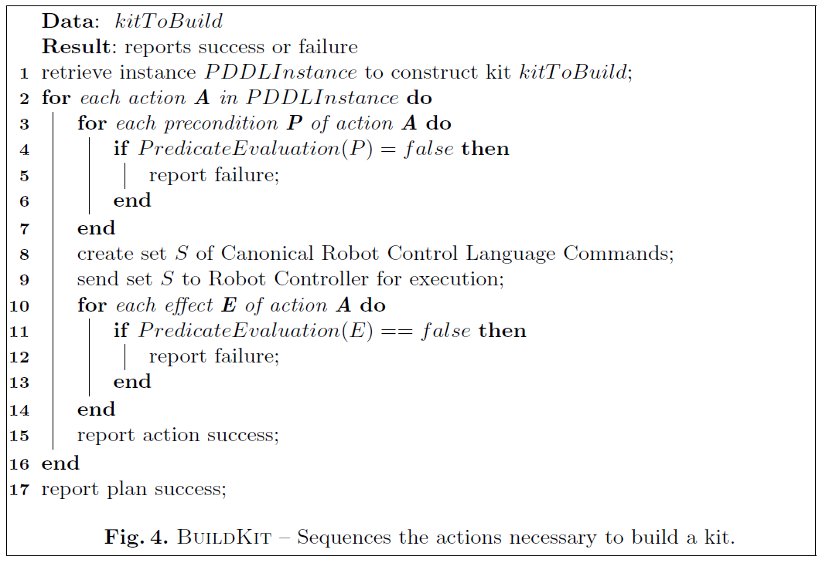
System Flow

Slide 13
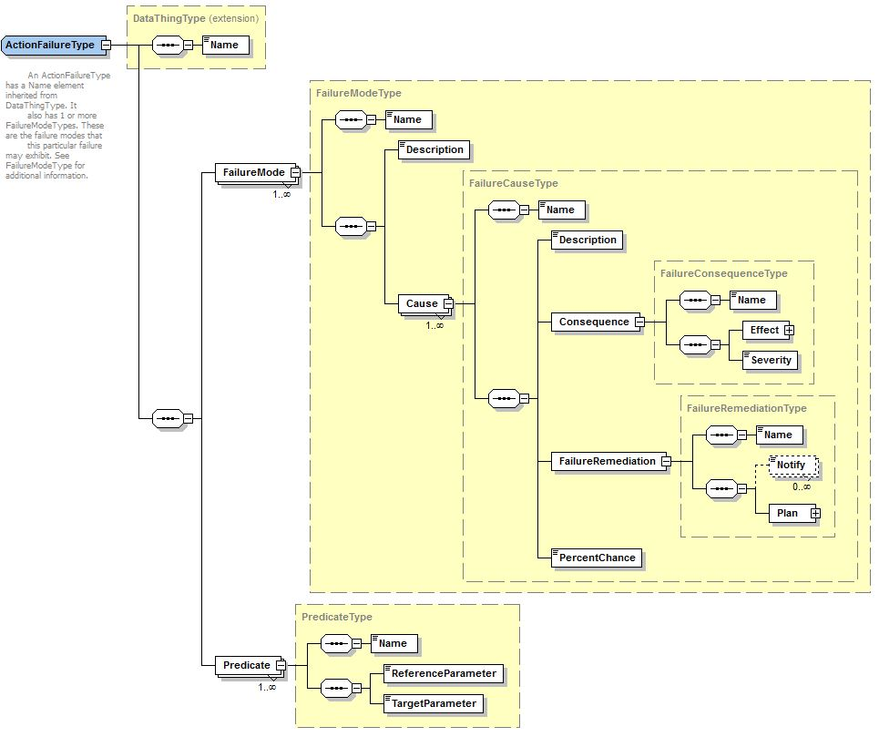
Failure Analysis
Some assembly failures may be predicted
Model may be developed that maps action predicates to failure modes
Model contains:
Consequence of failure
Remediation plan to correct failure

Slide 14
Failure Example
Action effect “part-in-gripper” not achieved for action “take-part”
Examination of action- predicate relationship allows failure mode to be set as “dropped part”
Consequence of failure is that the part must be re-inspected for damage
New plan segment retrieved from database and an additional “take-part” operation is performed

Slide 15
Conclusions
Framework applied to domain of kit building, which is a simple, but practically useful manufacturing/assembly domain
Demonstrated agility with late binding of part locations and detection of and recovery from action failures
Future work includes:
Implementation on actual kitting cell
Extensions to more general assembly operations

Slide 16

Questions

Slide 17
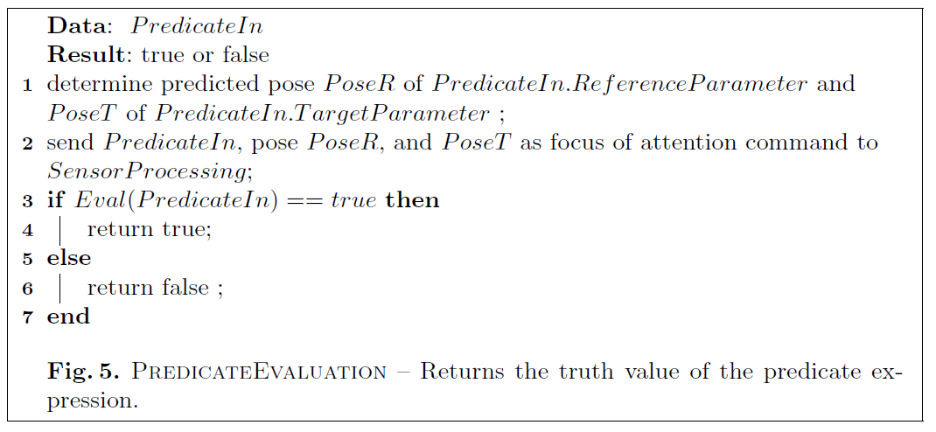

Slide 18
